Slide 1
Automated Image Classification and Repository Management System
Team YUV

Slide 2
Context - What are we building?
A System Which Encompasses the following:
Image Upload
Automated Classification - CNN Model/Fine tuned ResNet model
Image Repository Management - S3 Buckets and Tagging System
Search and Retrieval

Slide 3
SRS - Functional Requirements
The system shall
allow user registration and authentication
allow users to upload images via web interface in batch or individually.
automatically classify images using the CNN model upon upload.
automatically tag images based on classification results.
automatically store images in the appropriate repository based on tags and create a new repository if one doesn’t exist for the classified image type.
provide users with an image repository to view and manage classified images.
provide users with search functionality to find specific types of images.

Slide 4
SRS - Non Functional Requirements
Performance Requirements:
Classify images within 10 seconds of upload for individual images.
Support up to 50-100 concurrent users uploading and retrieving images without performance degradation.
Safety and Security Requirements:
Implement user authentication to prevent unauthorized access to the image repository.
Ensure secure transmission of images using HTTPS.
Software Quality Attributes:
Reliability: The system shall be available for 99% of the time other than the scheduled maintenance time.
Adaptability: User friendly user interface and user experience.
Usability: The system should be having as minimum number of human interactions such as clicks as possible to get the job done.

Slide 5
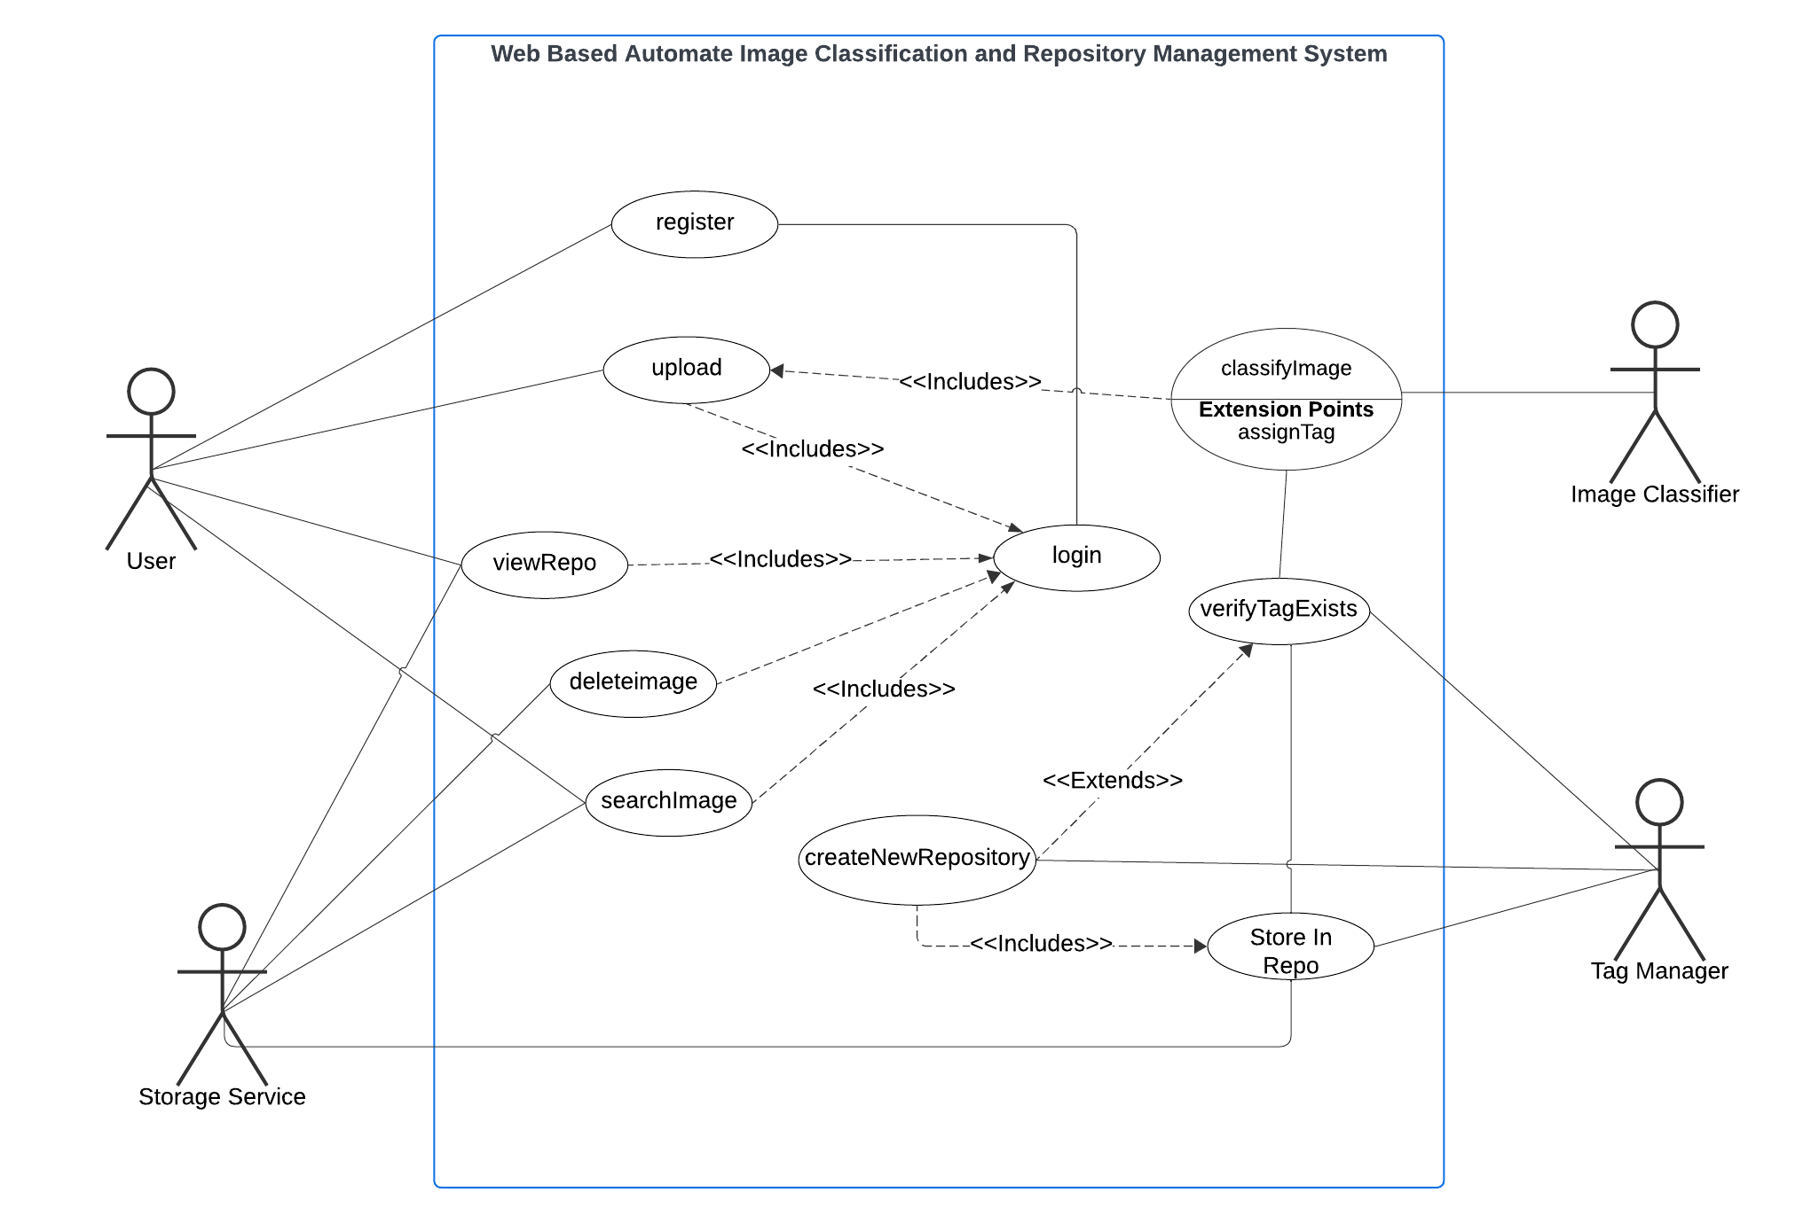
SRS - Use Case Diagram

Slide 6
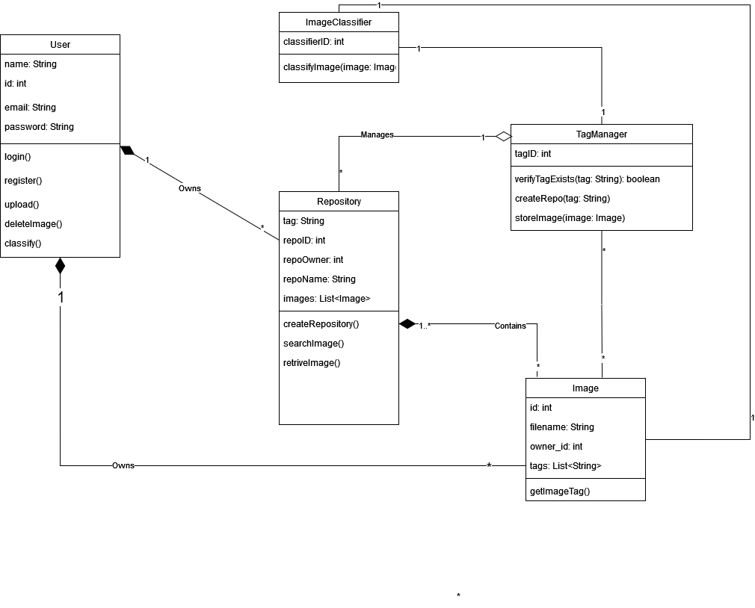
SRS - UML Diagram

Slide 7
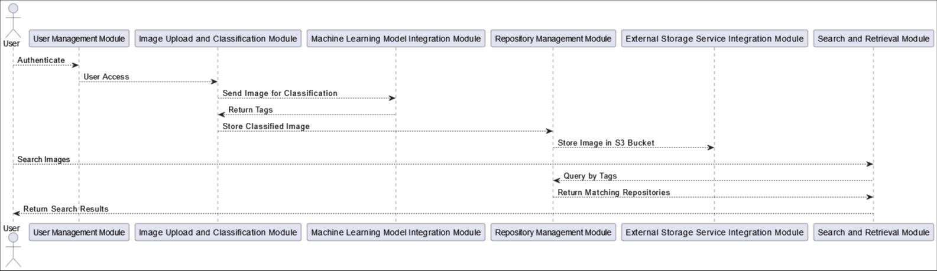
SRS - Modular Flow Diagram

Slide 8
Timeline
Planning: September 23, 2024 - September 25, 2024
SRS Review: September 26, 2024 - September 28, 2024
Setup Dev Environment: September 29, 2024 - October 1, 2024
Wireframe Design: October 2, 2024 - October 4, 2024
Core Development: October 5, 2024 - October 19, 2024
Frontend Development: October 20, 2024 - October 24, 2024
Backend Development: October 25, 2024 - October 28, 2024
ML Model Integration: October 29, 2024 - November 2, 2024
Cloud Setup: November 3, 2024 - November 7, 2024
Testing & Debugging: November 7, 2024 - November 16, 2024
Documentation & Deployment: November 17, 2024 - November 21, 2024
Final Review: November 22, 2024 - November 23, 2024

